Slide 1

Perki
The value you already pay for. Finally in one place.
A personal inventory of every perk hidden inside your subscriptions and memberships, across every provider.
Investor overview · 2026

Slide 2
THE PROBLEM
People pay for plenty. They use a fraction.
Subscriptions have piled up. The perks inside them sit unused, buried in apps and forgotten emails. People pay full price and leave the extras on the table.
£786
the average UK household spends on subscriptions a year
1 in 5
pay for something they barely use
Most
never claim the perks they are owed
Source: Aqua / Barclays UK subscription studies, 2025.
2

Slide 3
WHY NOW
The bill is rising, and so is the waste.
+57%
£1.6bn
£688m
growth in household subscription spend in three years
lost a year to forgotten subscriptions, double 2019
wasted a year on subscriptions people do not use
Shoppers watch every pound. Nobody shows them the value they already own. That gap is Perki.
Sources: Citizens Advice; Aqua / Barclays, 2025.
3

Slide 4
THE INSIGHT
Everyone helps you cancel.
We help you cash in.
The market is full of tools that find subscriptions to cut. Perki does the opposite. It shows you the perks you already pay for, so your money finally works.
4

Slide 5
THE PRODUCT
One clean inventory of everything you own and are owed.
Perki is not an AI bot. It's an engagement driver.
Everything in one place
Tier-aware
Features, perks, discounts and competitions across all your providers.
We show what is actually yours, matched to your exact plan.
Never miss one
Read-only and private
Reminders before perks reset or expire, by email (weekly or daily) and app notifications.
Perki shows you value. It never moves or touches your money.
5

Slide 6
HOW IT WORKS
Three taps to everything you are owed.
1
2
3
Add your subscriptions
Perki maps your tier
Claim and track
Add the providers and memberships you already pay for.
We match every perk to your exact plan. No noise.
Claim it, track it, and never miss a reset.
6

Slide 7
THE EXPERIENCE · 1 OF 2
A marketplace to explore.
A comparison site for the perks inside everything you pay for. Search every provider and every tier in one place.
No account needed.
Open to everyone
Anyone can browse the full library before they sign up. Think Martin Lewis or a price comparison site.
A public library anyone can search, not just members. Free and open, it is the top of the funnel that pulls people in before they ever create an account.
Every provider and tier, in one library
Every perk priced and categorised
Find the cheapest tier a perk lives in
7

Slide 8
THE EXPERIENCE · 2 OF 2
A profile that pays you back.
Sign in and Perki gets personal. It tracks your memberships, your active and inactive perks, and the value you have claimed.
Your memberships and monthly cost
Active vs inactive at a glance
Everything you pay for, totted up in one number.
See what you use and what you are missing.
Mark as used
Unclaimed value, falling to zero
Track the value you claim over time.
A running score of money still on the table.
8

Slide 9
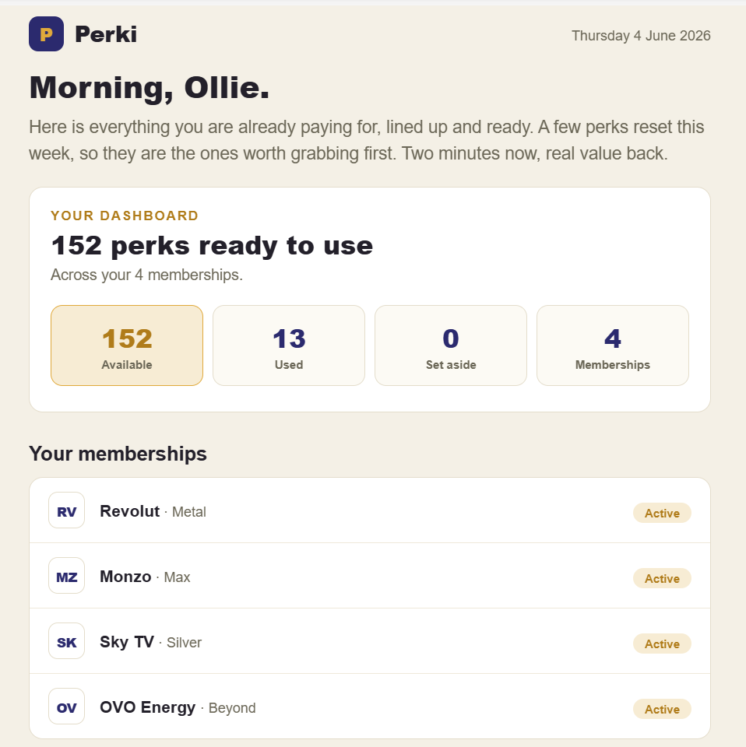
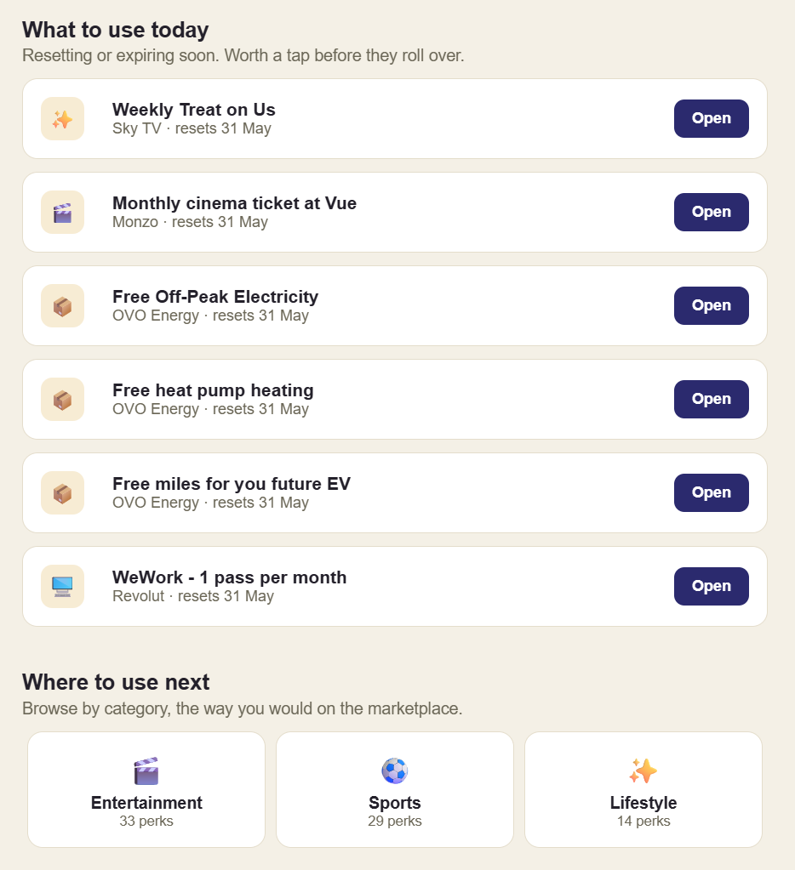
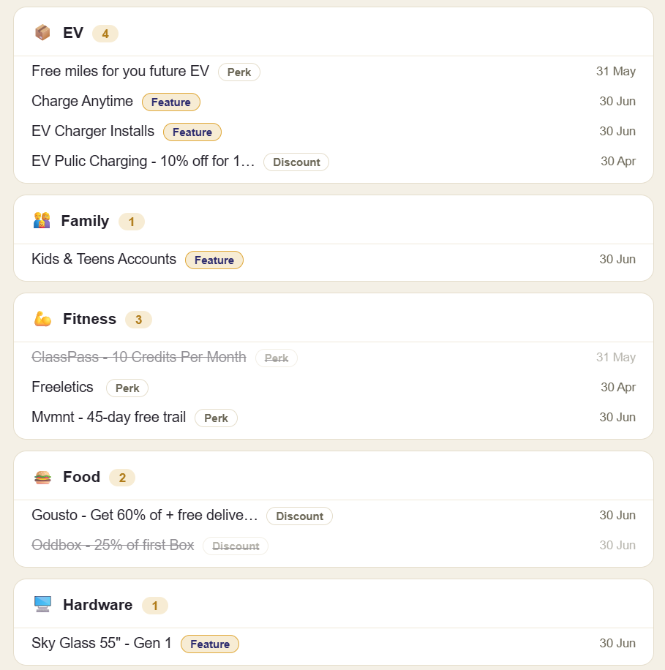
See it in action
Your daily 7am email, generated from your live perks.
The morning digest opens with your value at a glance: perks ready, what you have used, and your active memberships.
What to use today: time-sensitive perks with one-tap deep links, plus category shortcuts into the marketplace.
All your perks by category, each tagged Perk, Feature or Discount, with reset dates.
Perki app · shown on the next slide

Slide 10
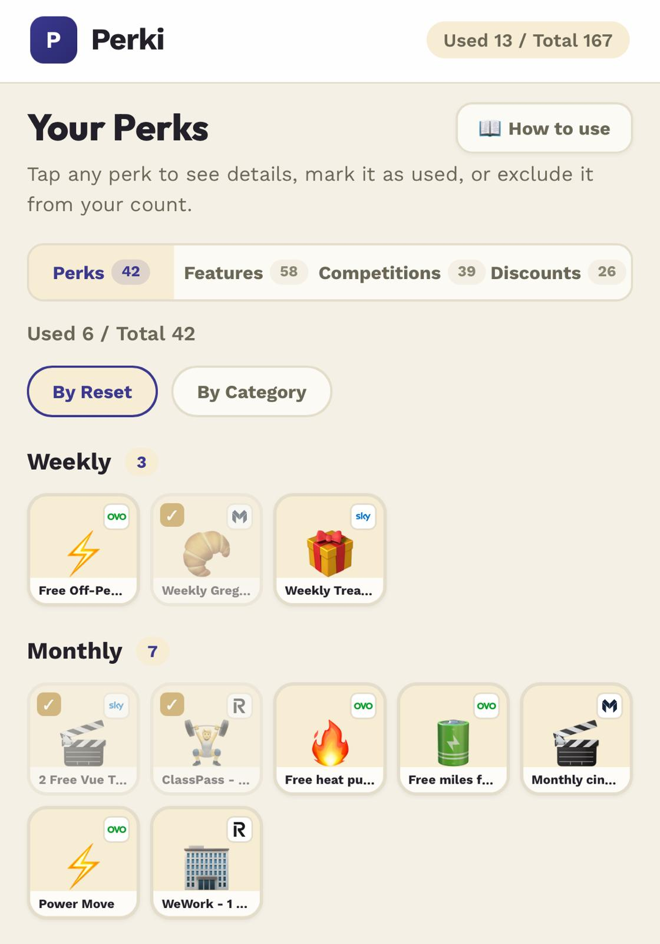
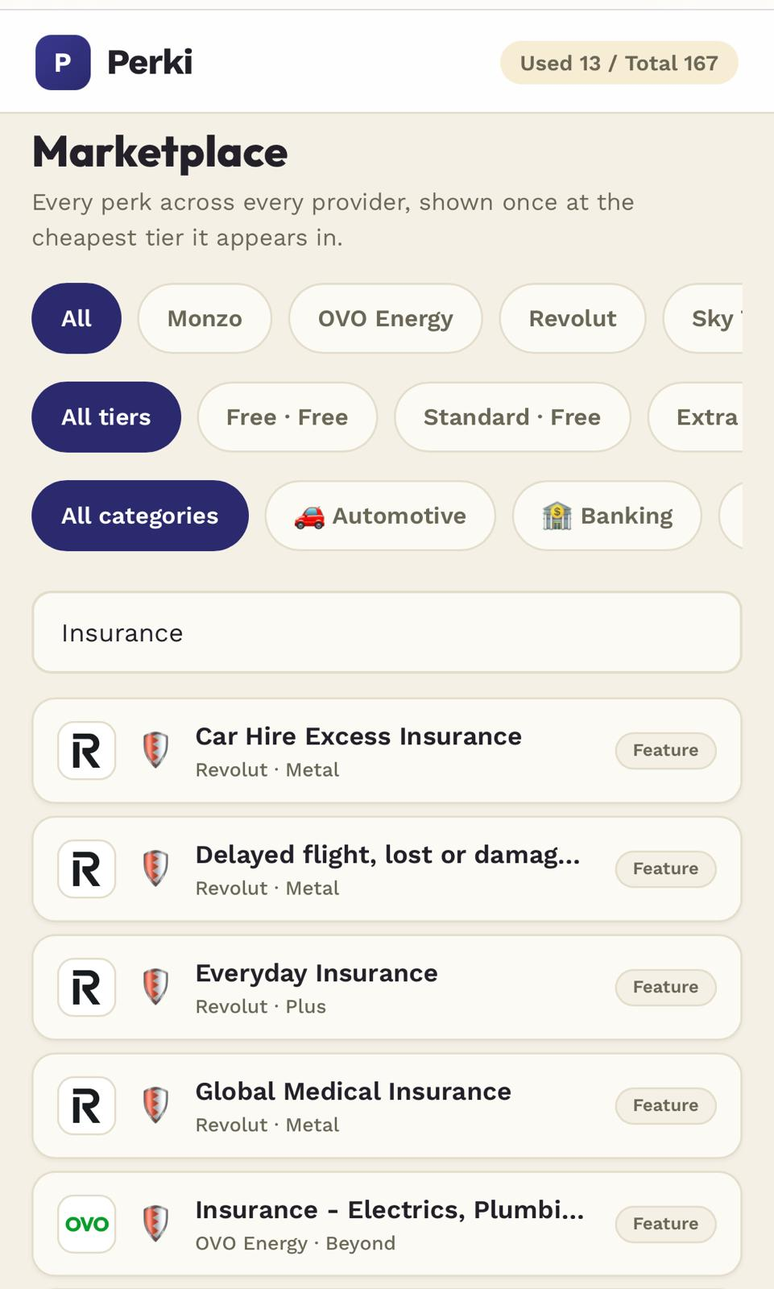
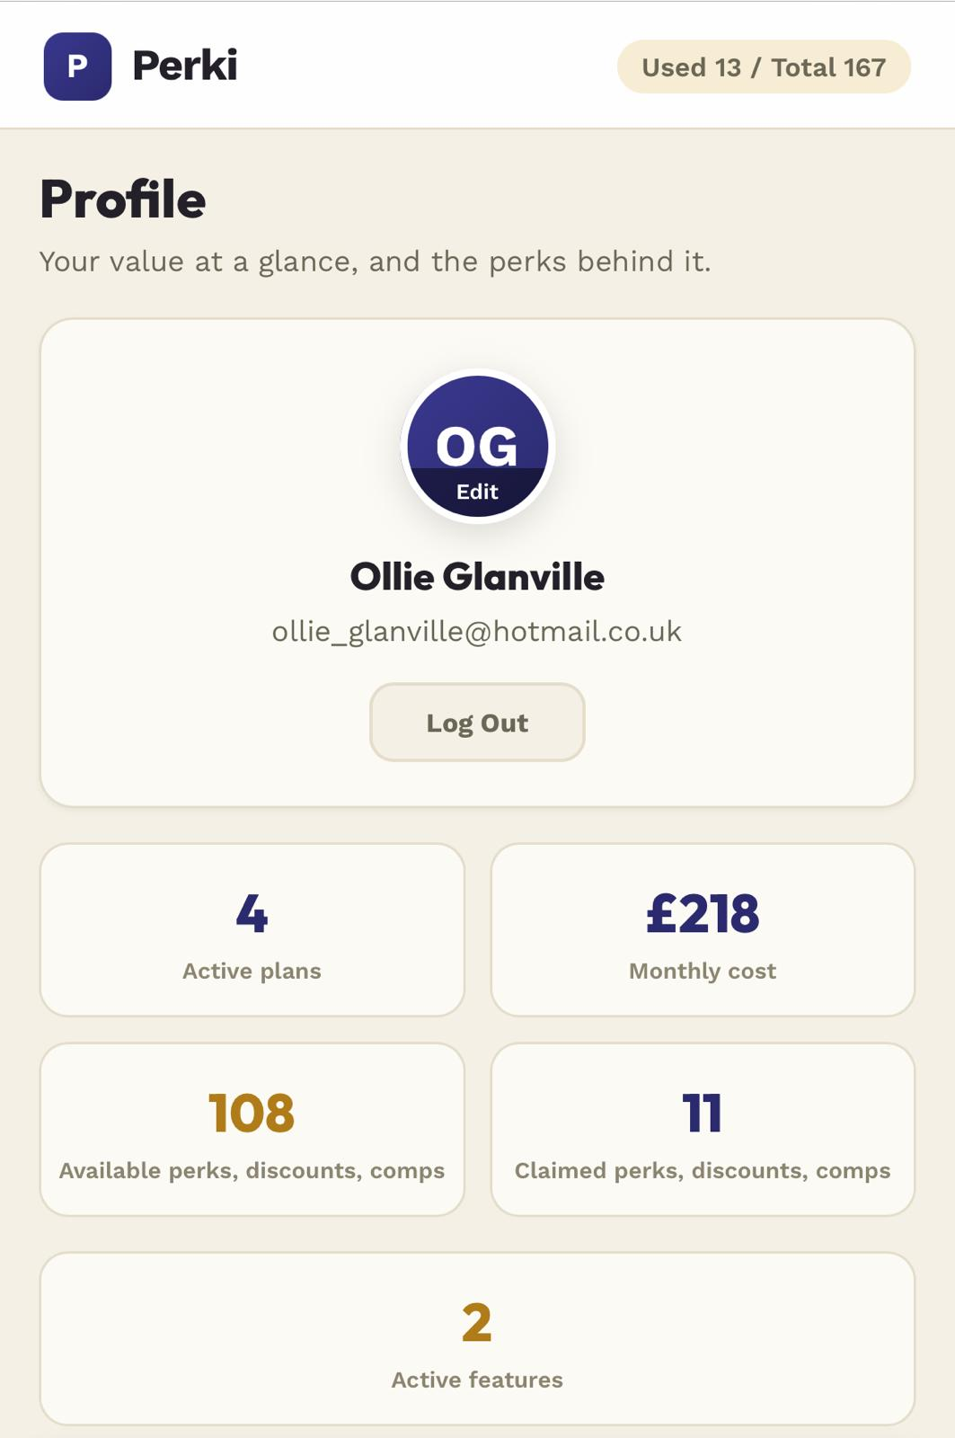
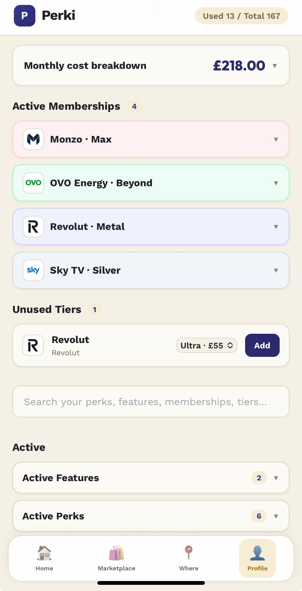
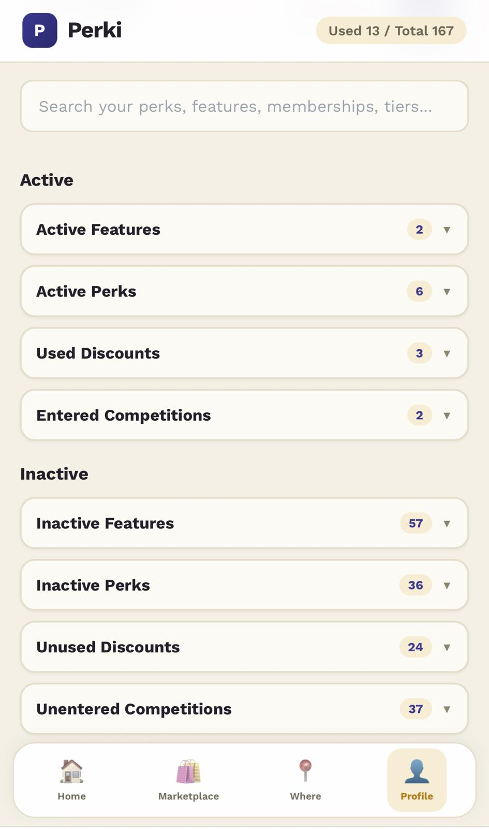
Inside the app
Home, marketplace and profile, in your hand.
Home: every perk you hold, in a tappable grid.
Marketplace: every perk, filtered by membership, tier and category.
Profile: your value at a glance, with the monthly cost.
Active memberships by provider and tier, plus upgrade tiers.
The active and inactive split, in plain language.

Slide 11
WHY PERKI WINS
Nobody offers a cross-provider perk inventory.
Bank & card perks
Monzo, Revolut, Amex
Only their own perks. One bank, one silo.
Cashback & coupons
Honey, TopCashback
New discounts at checkout. Not what you already own.
Cancellation apps
Emma, Rocket Money
They help you spend less. We help you use more.
Perki is the only one that pulls every provider into one personal view of value you can act on.
11

Slide 12
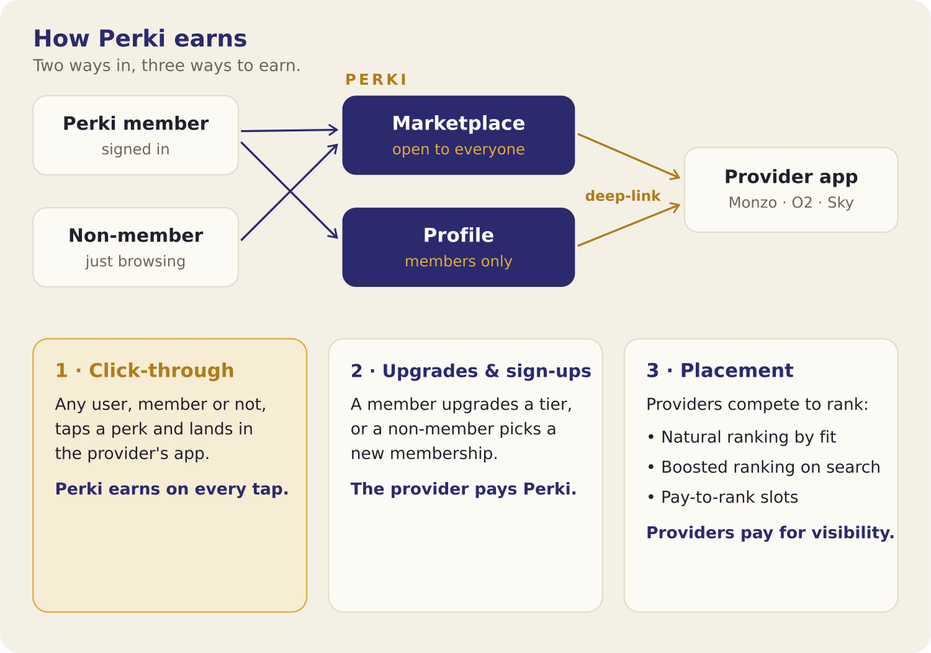
BUSINESS MODEL
Free for users. We earn from the marketplace.
12

Slide 13
WHERE WE ARE
Built, branded, and live.
Live product
288 perks catalogued
A mobile-first web app with a marketplace, profiles, and perk tracking.
Across Monzo, Revolut, Sky and OVO, validated and tier-accurate.
Real data backend
Full brand and system
A Supabase catalogue holding memberships and per-user perk state.
Identity, logo, design system and voice, ready to scale.
Live now at perki-app.vercel.app
13

Slide 14
ROADMAP
From inventory to marketplace.
Now
Next
Later
Deepen the catalogue. Add as many brands and tiers as possible to strengthen the MVP.
Test with friends across the website, app, and email blast. Sharpen the core loop on real users.
A partner portal and API so companies can integrate their perks directly.
14

Slide 15
TEAM
Commercial, technical, shipping.
OG
Ollie Glanville · Founder
Commercially-minded operator working across strategy, data and product. Turns messy problems into clear plans and lightweight systems that scale.
Hiring next: Technical lead to build API capability. Analyst to expand the catalogue.
THE ORIGIN
Perki began at an airport gate, hunting through a jumble of memberships, cards and perks to work out which lounge I could actually use. Bouncing between apps, emails and websites to remember my tier and what I was owed, it struck me as absurd that nothing simply told me what I get. Tired and annoyed, that is where Perki was born: one place to see every perk, benefit, discount and feature you already pay for, and to make sure you actually use them.
15

Slide 16
Make every perk count.
Perki turns value people already pay for into value they actually use. We are building the layer that sits on top of every subscription you own.
ollie_glanville@hotmail.co.uk · perki-app.vercel.app

